Slide 1
Relations IN MONGODB
By
Akhil m anil

Slide 2
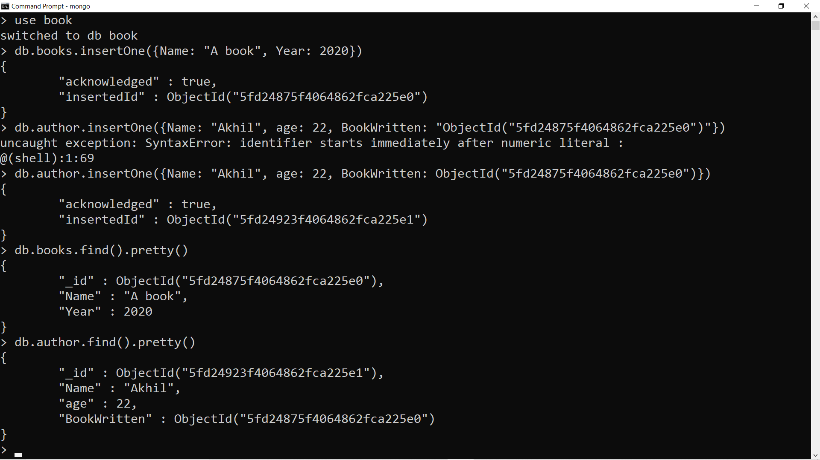
ONE to ONE Relation

Slide 3
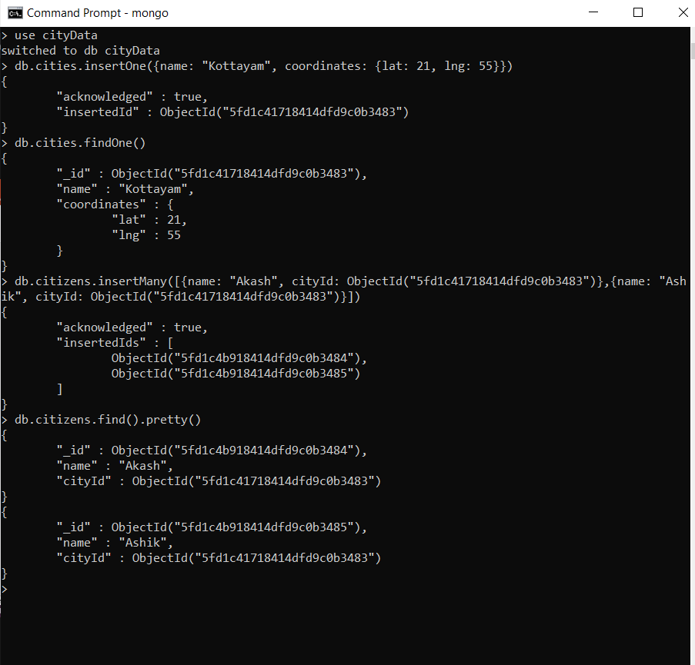
ONE to MANY Relation

Slide 4
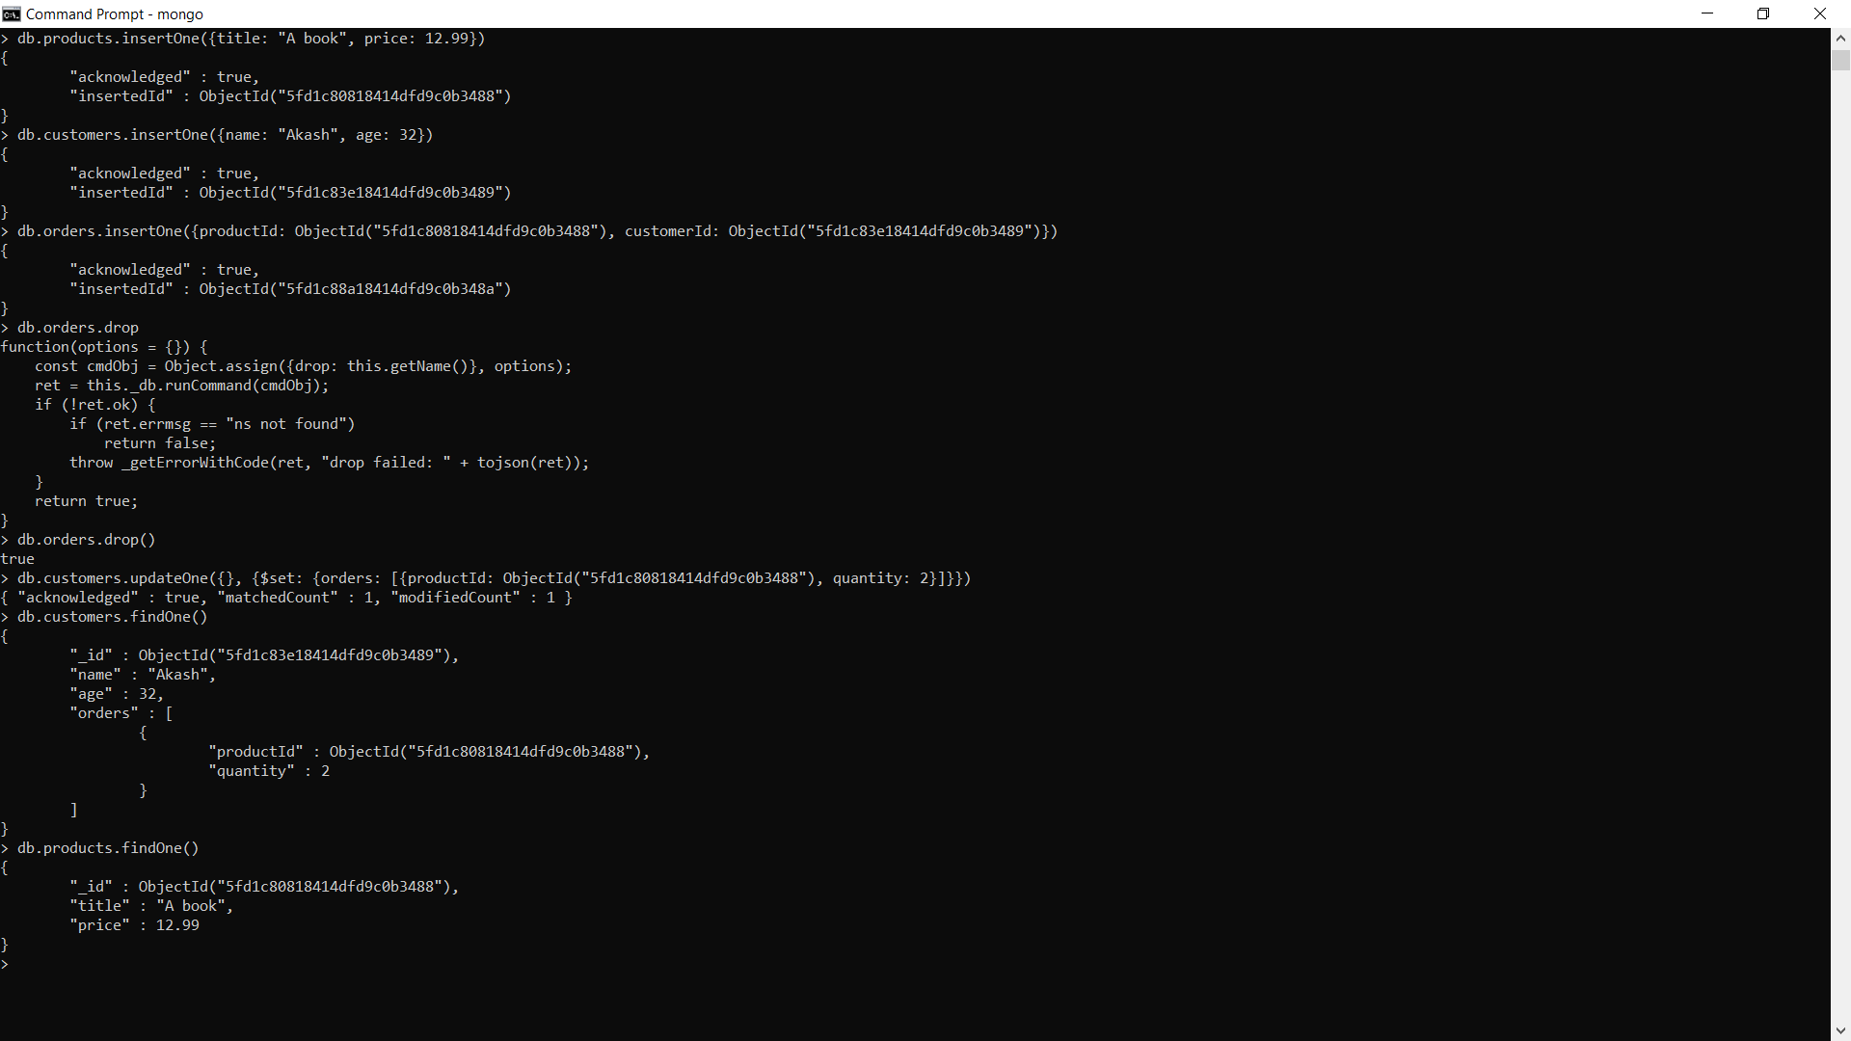
MANY to MANY Relation

Slide 5
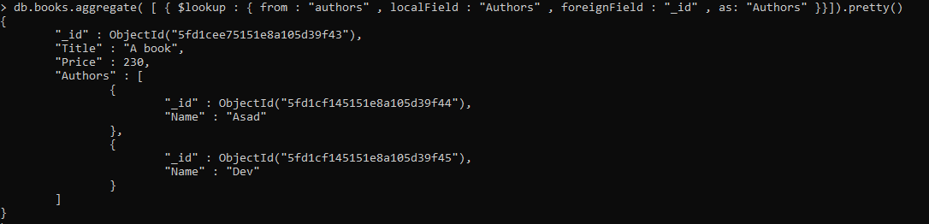
Joining using $lookup

Slide 6
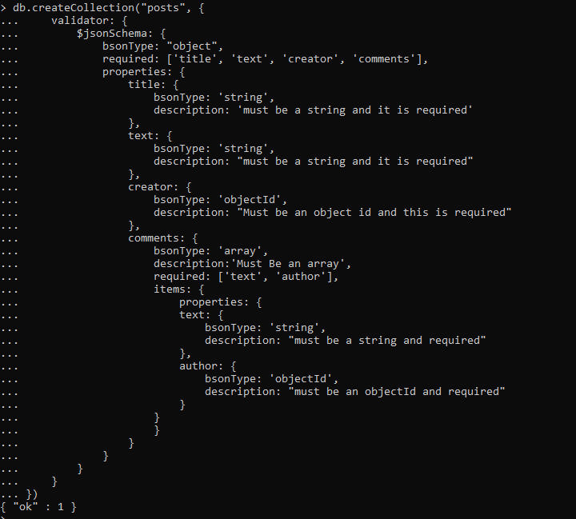
Validation Schema

Slide 7
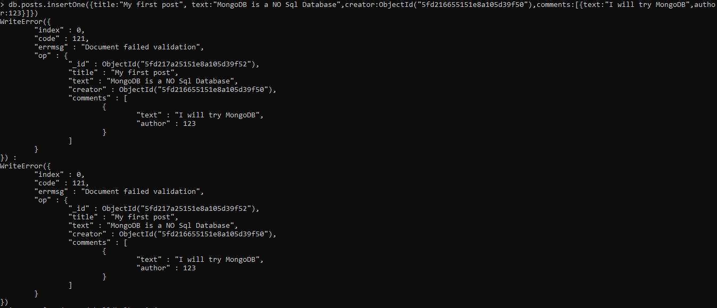
Validation Schema Test

Slide 8
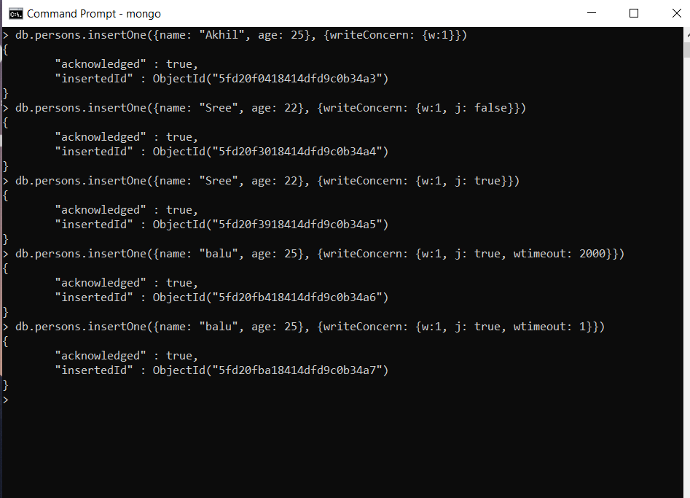
writeConcern

